Slide 1

BOUNCING BALL
PRESENETED BY VIGNESH.N.M AND UJJWAL KUMAR

Slide 2
INTRODUCTION
Computer graphics are graphics created using computers and more generally, the representation and manipulation of pictorial data by a computer. The development of computer graphics has made computers easier to interact with and better for understanding and impact on many types of media and have revolutionized the animation and video game industry interpreting many types of data. Developments in computer graphics have had a profound.

Slide 3
ABOUT OPENGL
OpenGL provides a powerful but primitive set of rendering commands, and all higher-level drawing must be done in terms of these commands. Also, OpenGL programs have to use the underlying mechanisms of the windowing system. A number of libraries exist to allow you to simplify your programming tasks, including the following

Slide 4
The OpenGL Utility Library (GLU) contains several routines that use lower-level OpenGL commands to perform such tasks as setting up matrices for specific viewing orientations and projections, performing polygon tessellation, and rendering surfaces. This library is provided as part of every OpenGL implementation. Portions of the GLU are described in the OpenGL Reference Manual.
The OpenGL Utility Toolkit (GLUT) is a window system-independent toolkit, written by Mark Kilgard, to hide the complexities of differing window system APIs.

Slide 5
ADVANTAGES OF COMPUTER GRAPHICS
Information visualization
Computer vision
Image processing
Computational geometry
Computational topology
Scientific visualization
Applied mathematics

Slide 6
MODULE DESCRIPTION
The GLUT library functions used are:
void glEnable(GLenum cap) - enables server-side GL capabilities.
cap - specifies a symbolic constant indicating a GL capability.
void glTranslatef( GLfloat x, GLfloat y,GLfloat z) - multiply the current matrix by a translation matrix.
x, y, z - Specify the x, y and z coordinates of a translation vector.
glRotatef - multiply the current matrix by a rotation matrix.
void glRotatef( GLfloat angle, GLfloat x, GLfloat y, GLfloat z) angle- Specifies the angle of rotation, in degrees.
x,y,z - Specify the x,y, and z coordinates of a vector respectively

Slide 7
void glutInit(int *argc, char **argv);
argc - A pointer to the unmodified argc variable from the main function.
argv - A pointer to the unmodified argv variable from the main function.
void glutInitWindowPosition(int x, int y);
x - the number of pixels from the left of the screen. -1 is the default value,meaning it is up to the window manager to decide where the window will appear. If not using the default values then you should pick a positive value, preferably one that will fit in your screen.
y - the number of pixels from the top of the screen.
void glutInitWindowSize(int width, int height);
width - The width of the window, height - the height of the window.

Slide 8
void glutInitDisplayMode(unsigned int mode);
mode - specifies the display mode.
The mode parameter is a Boolean combination (OR bit wise) of the possible
predefined values of the GLUTlibrary. You use mode to specify the color
mode,and the number and type of buffers. The predefined constants to specify
the color model are:
GLUT_DOUBLE – double is used for smooth animation, it requests the second
frame buffer from the system.
GLUT_DEPTH - It is another buffer to hold the depth of each pixel.
int glutCreateWindow(char *title);
title - sets the window title.
The return value of glutCreateWindow is the window identifier.

Slide 9
void glClearColor( GLclampf red, GLclampf green, GLclampf blue, GLclampf alpha);
Specify clear values for the color buffers red, green, blue, alpha .Specify
blue, and alpha values used when the color buffers are cleared. The initial
value of all.
voidglMatrixMode(GLenummode);
Specify which matrix is the current matrix.
glMatrixMode sets the current matrix mode. mode can assume one of four
values.
GL_MODELVIEW
Applies subsequent matrix operations to the model view matrix stack.
GL_PROJECTION
Applies subsequent matrix operations to the projection matrix stack

Slide 10
void glutMainLoop(void);
This routine should be called at most once in a GLUT program. Once called, this routine will never return. It will call as necessary any callbacks that have been registered.
glutPostRedisplay(void);
Marks the current window as needing to be redisplayed
void glLoadIdentity(void);
Replace the current matrix with the identity matrix
void glColor3f( GLfloat red, GLfloat green, GLfloat blue )
v -Specifies a pointer to an array that contains red, green, blue, and
sometimes alpha vertices.
Void glutDisplayFunc(void(*func)(void));
Sets the display call back for the current window the new display call back function.

Slide 11
`
glutKeyboardFunc(void (*func)(unsigned char key,int x,int y));
func is called when event of keypress happened. x,y specify mouse position
when key is pressed. In this sample function, func is void Keyboard(unsigned
char key,int x,inty).
glFlush(); This FUnction is used to Flush(Display) the output on the screen.
glIdleFunc(update scene); Its a CallBack Function for the Matrix

Slide 12
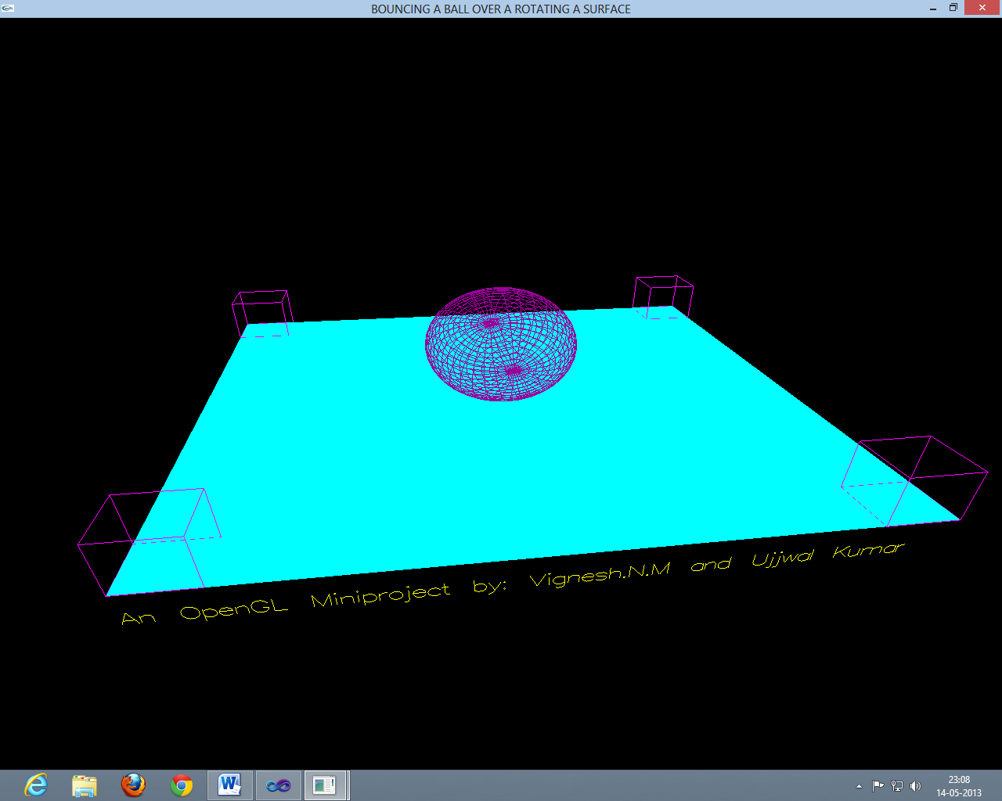
Screen shot 1(a): Zero the rotation rates
Screen shot 1: Ball on a plane surface.

Slide 13
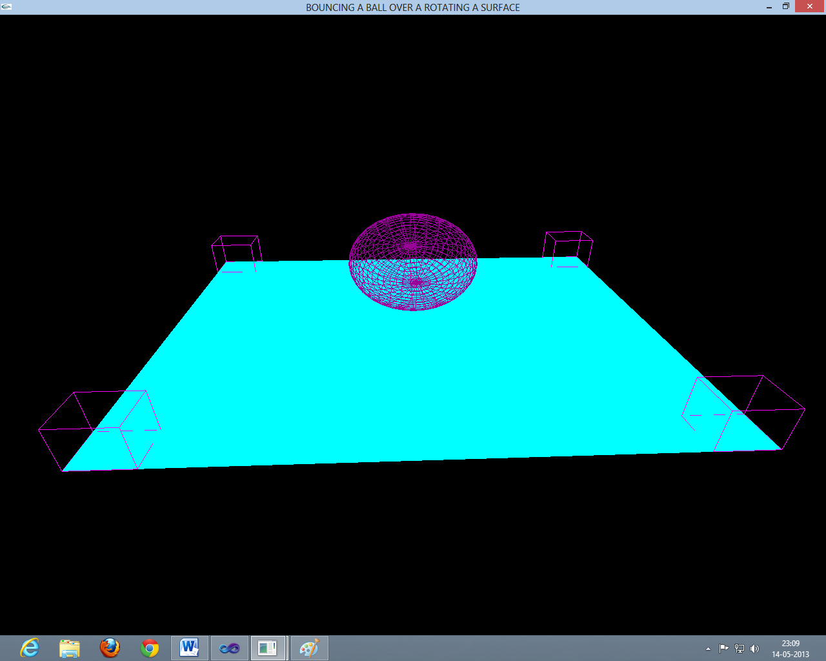
Screen shot 2:Front view of a bouncing ball.

Slide 14
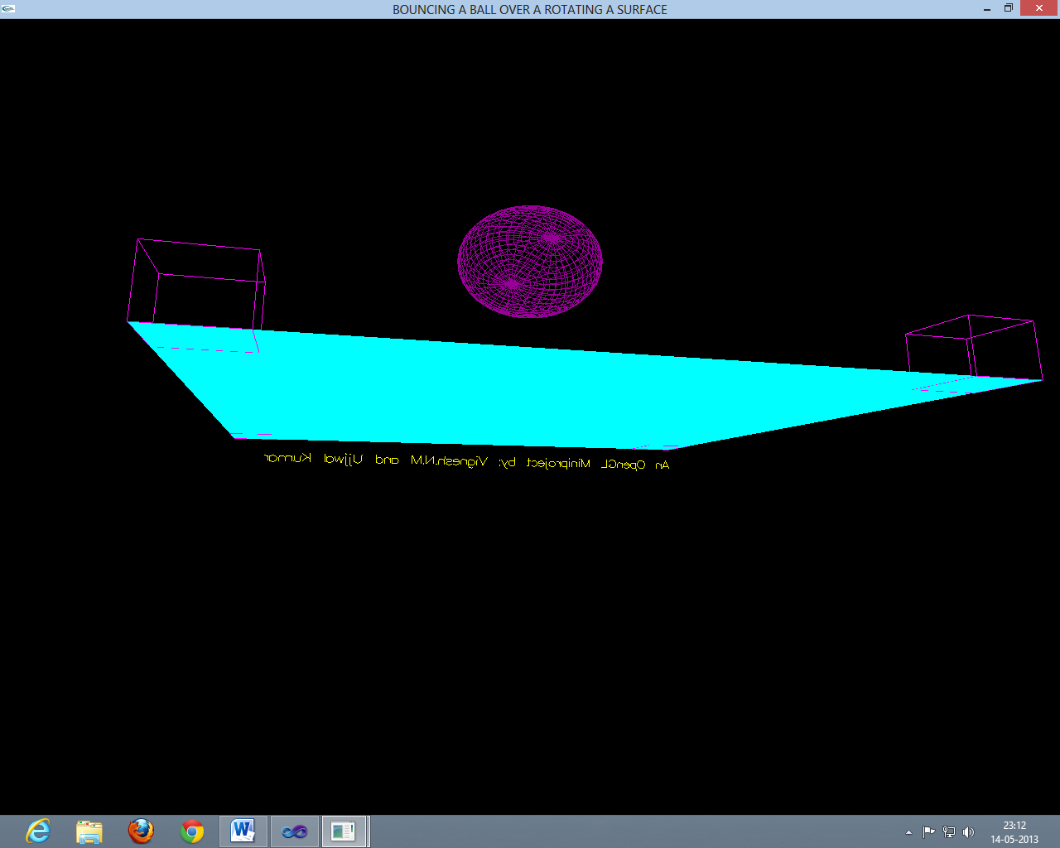
Screen shot 3: Bouncing ball in the air.

Slide 15
FUTURE
ENHANCEM
ENTS
In this package we may consider the further enhancements like-
Different objects can be displayed.
We can change the pattern to mesh and some different textures.
Different colors can be implemented for the Ball as well as the Plane.
The size of the Ball and the Plane can be increased and decreased.
This project can be done with more options.

Slide 16
CONCLUSION
We started with a modest aim, with no prior experience in any programming projects such as this, but ended up in learning many things, fine tuning my programming skills and getting into the real world of software development with an exposure to corporate environment. During the development of any software of significant utility, we are faced with the trade-off between speed of execution and amount of memory consumed. This is a simple interactive application. It is extremely user friendly and has the features, which makes simple graphics project. It has an open source code and no security features has been included. The user is free to alter the code for future enhancement. Checking and verification of all possible types of the functions are taken care. Care was taken to avoid bugs. Bugs may be reported to creator as the need may be. So, I conclude on the note that I am looking forward to develop such projects with an appetite to learn more in the field of computer science.

Slide 17
REFERENCES
Websites
www.opengl.org
www.glprogramming.com
www.wikipedia.org
Reference Books
Interactive Computer Graphics – Edward Angel –5thedition PearsonEducation−2009.
Computer Graphics C Version−Donald Hearn & M Pauline Baker−2nd Edition.

Slide 18
¿
ANY QUESTIONS

Slide 19
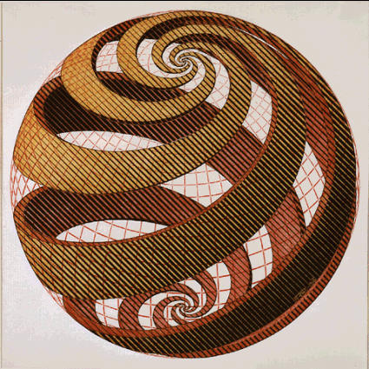
THANK YOU

